Slide 1
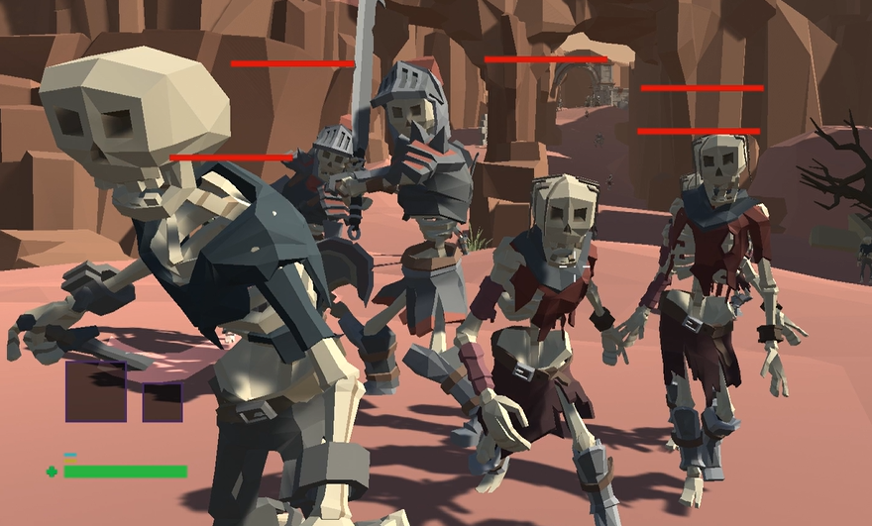
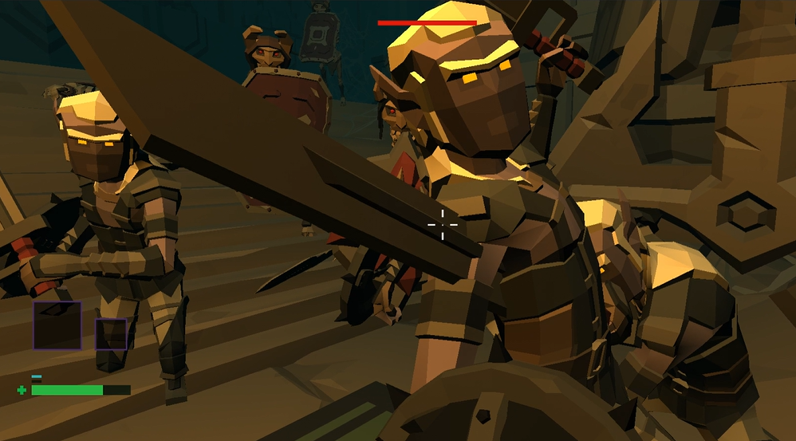
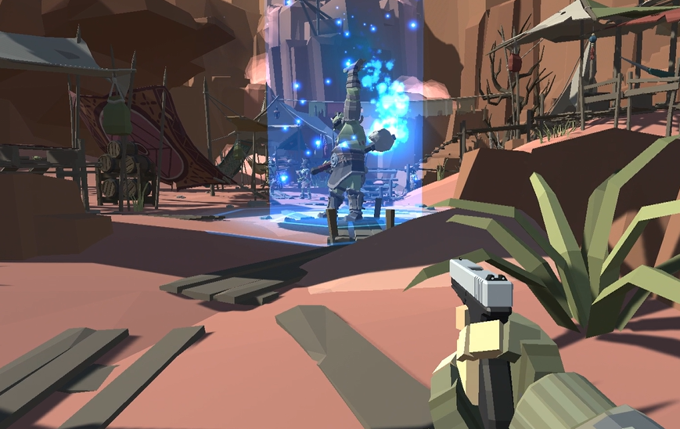
Karma is a First-Person Shooting game that gives players an awesome FPS experience while exploring different maps, skills trees, and customizable elements in RPG crawlers.
Presented by Poly Gamers: Hongda Lin, Baihua Yang, Jason Lian
Spring 2022, CSE 5912

Slide 2
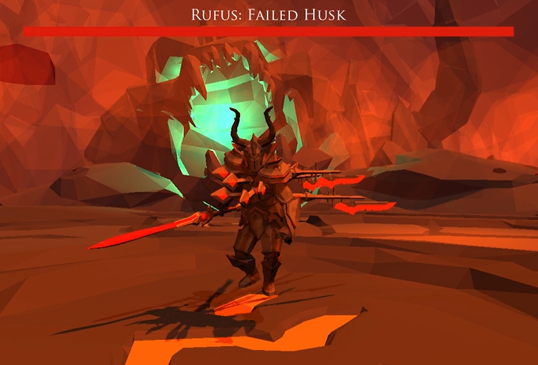
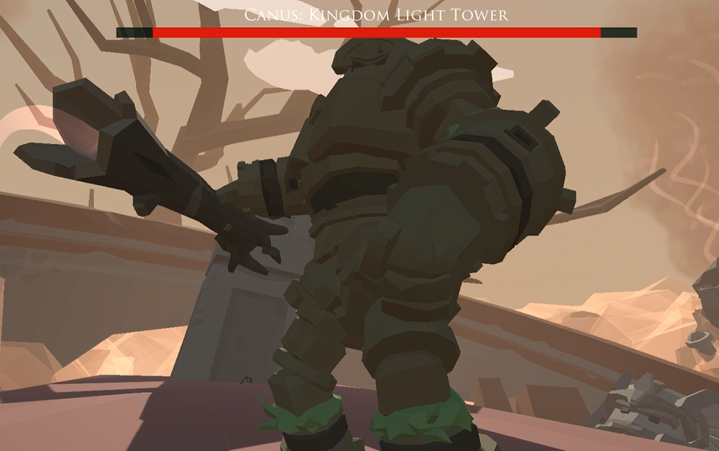
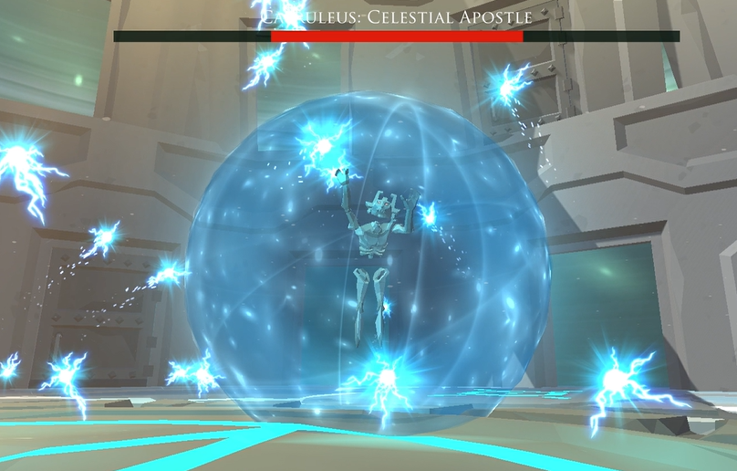
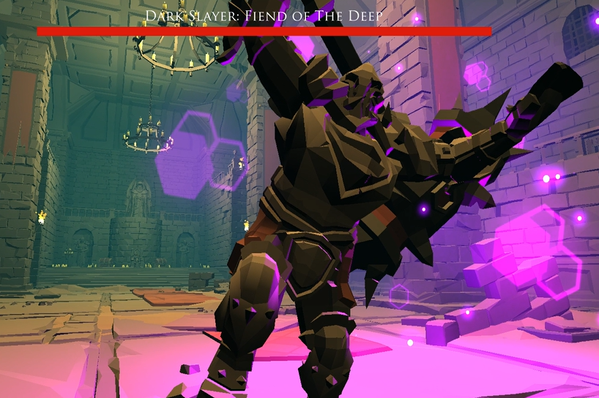
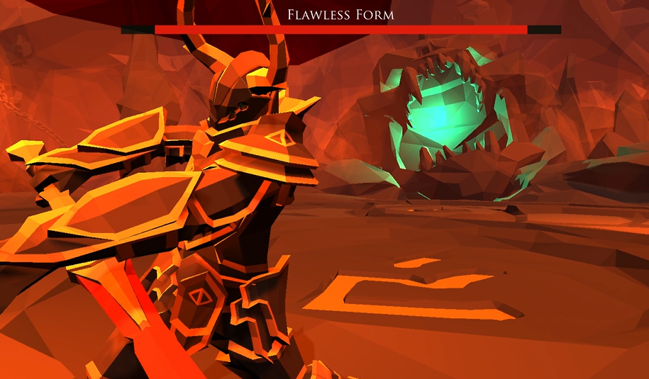
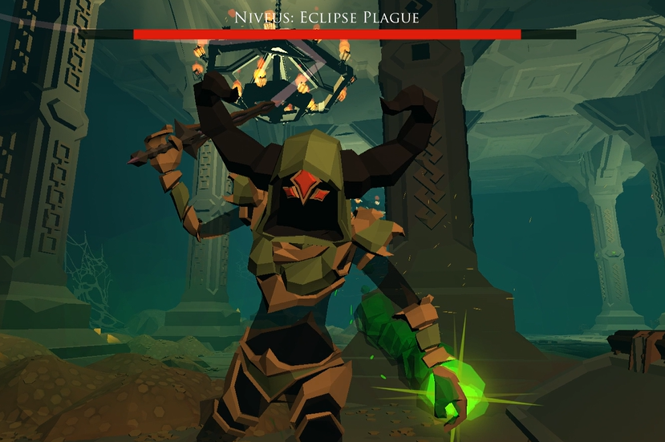
Karma has 3 levels, 5 bosses, and 22 different enemies for players to challenge.

Slide 3
Keyboard Bindings
Mouse
Left Mouse: Shoot
Right Mouse: Aim
WASD: Movement
X: Activate
TAB: Open Inventory
SHIFT: Sprint
R: Reload
ESC: Open Menu
SPACE: Jump
F: Main Skill
1~5: Switch Weapon
Mouse Wheel: Switch Weapon
Q, E: Left / Right Lean Shooting
V: Melee Attack
T: Pick Up
C: Crouch
Z: Teleport
L: Inspect
Camera Movement

Slide 4
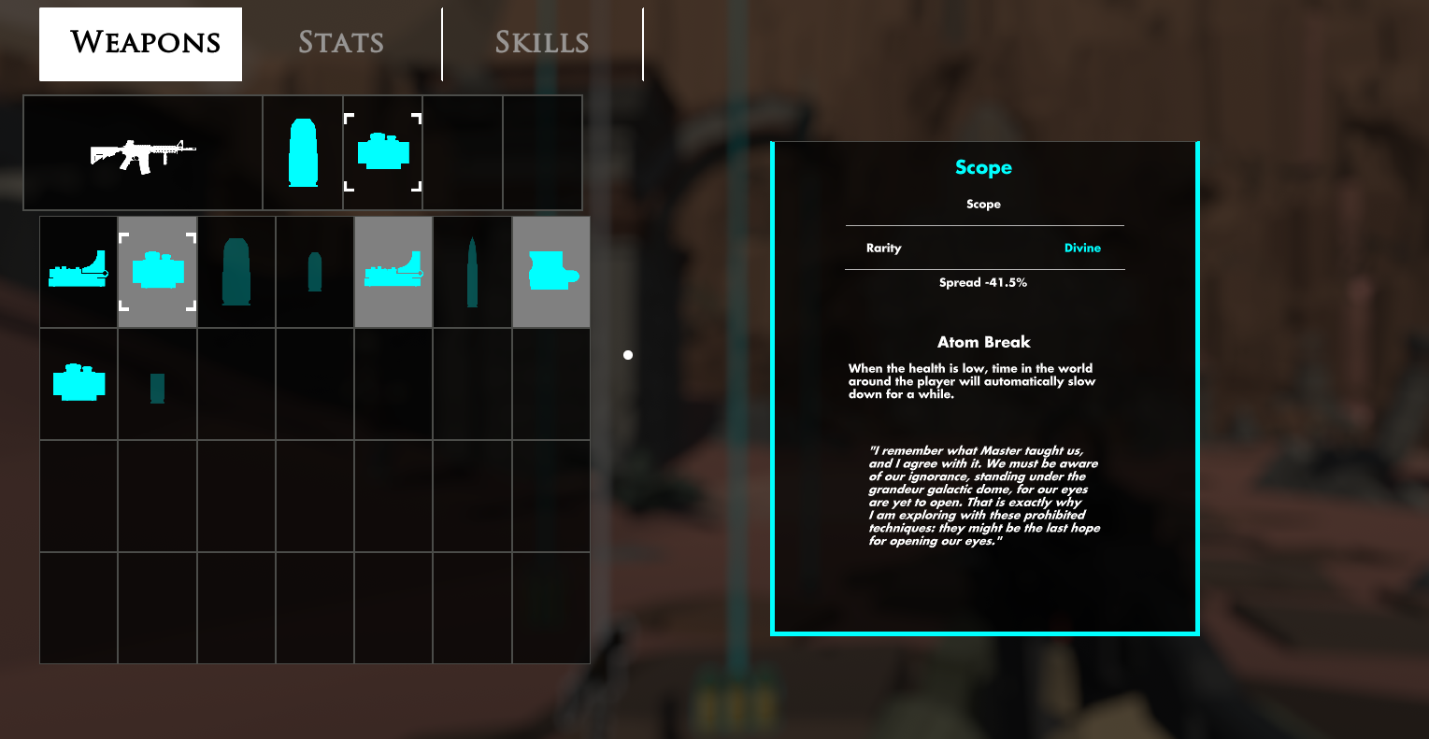
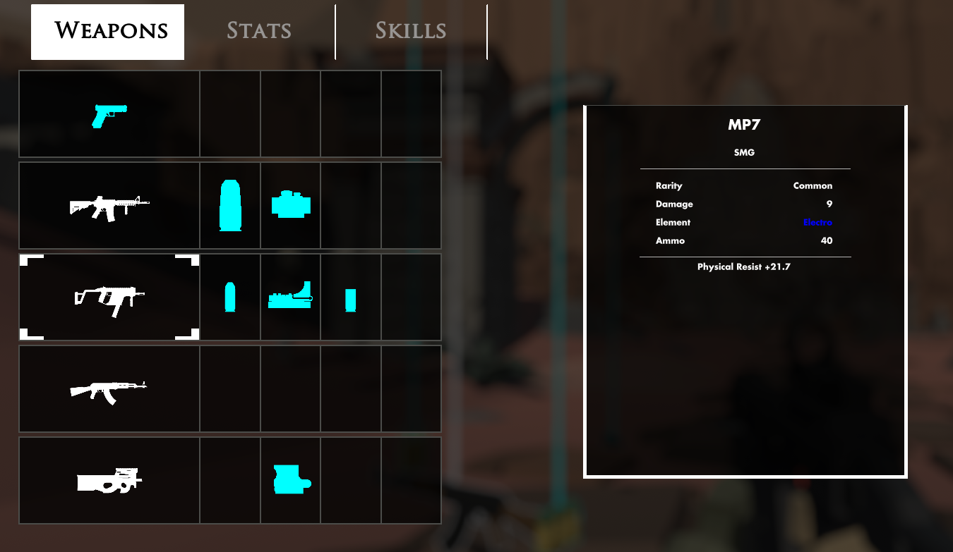
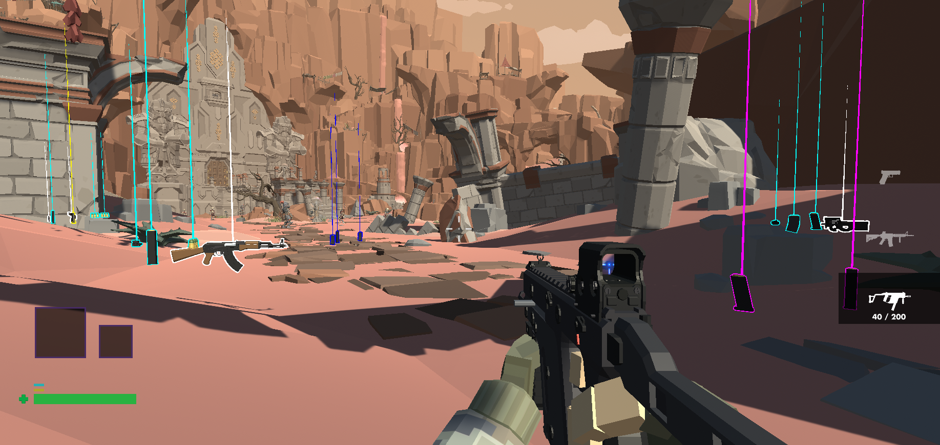
Karma has weapon system like CONTROL. With 13 weapons, 9 attachments, 6 runes, with up to 5 rarities and elemental types for players to collect.

Slide 5
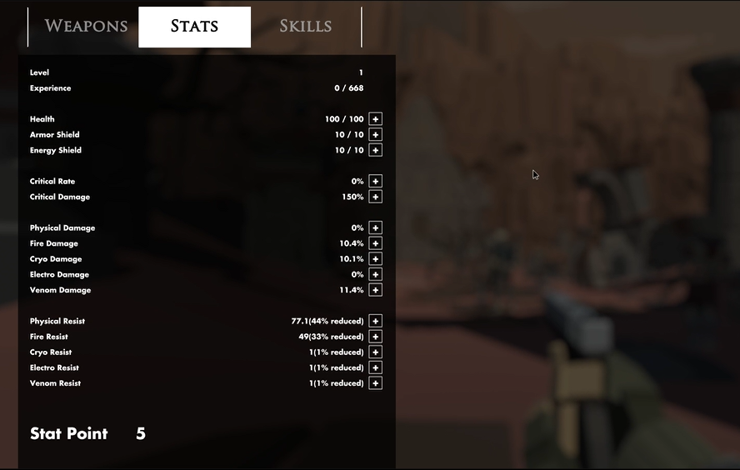
Karma has a stats system like Dark Souls for player to level up and customize (Health, Armor, Damage, Resistance).

Slide 6
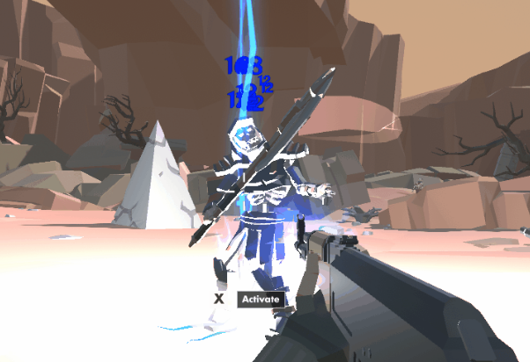
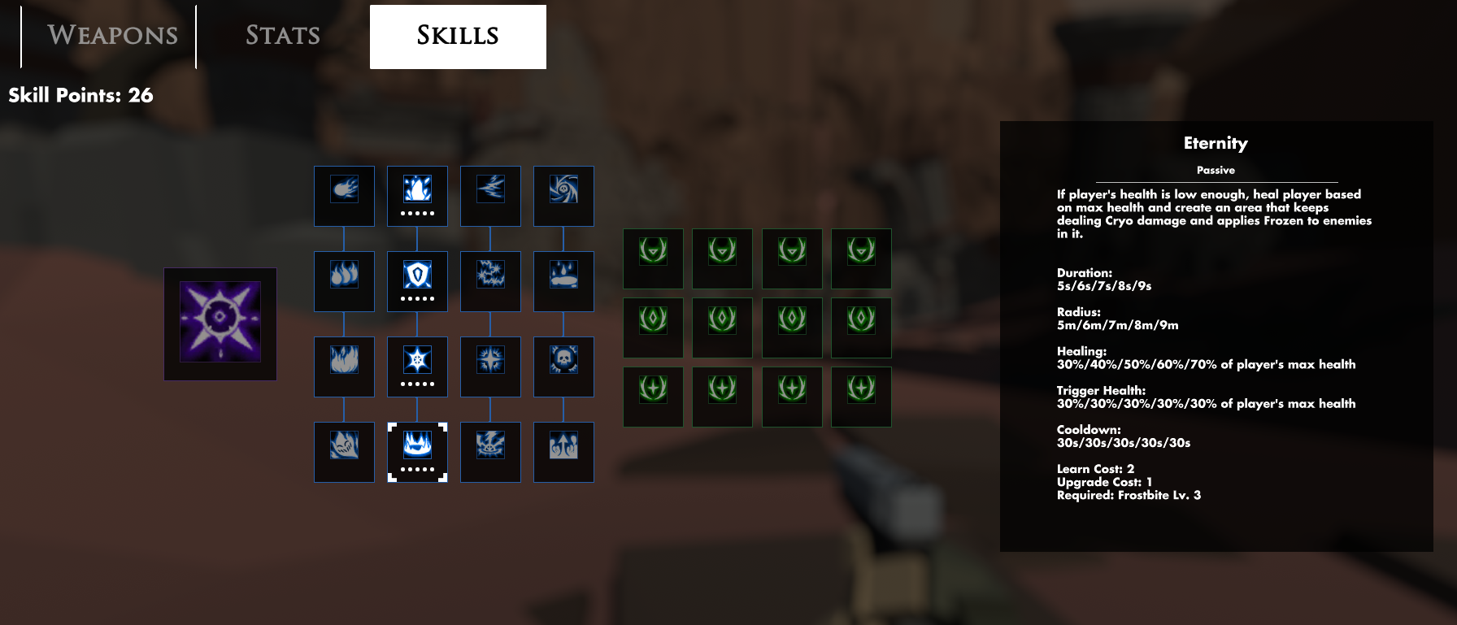
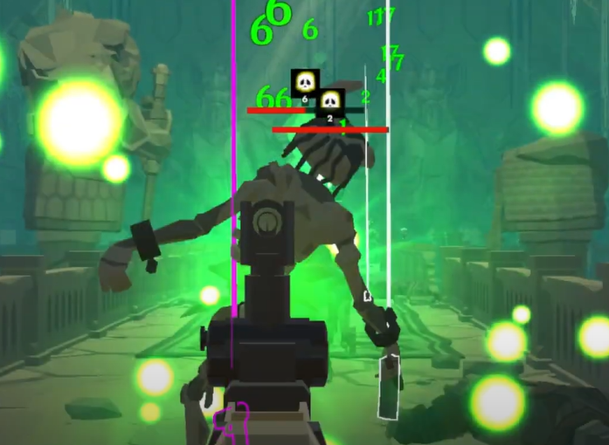
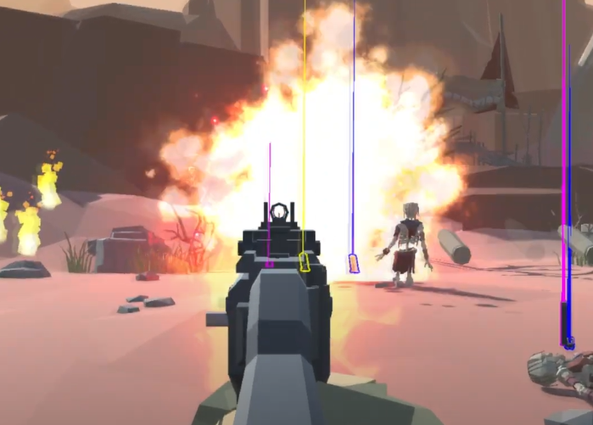
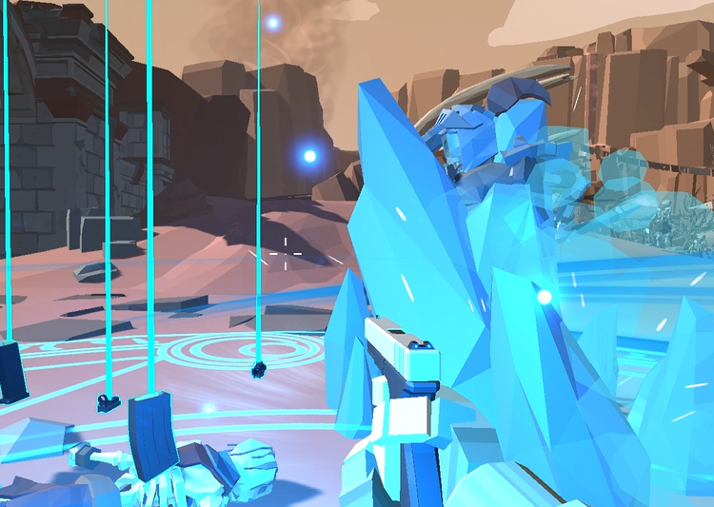
Electro
Karma has skill trees like BorderLands, with 4 elemental branches, 12 passive skills, 17 active skills for players to unlock.
Venom
Fire
Cryo

Slide 7
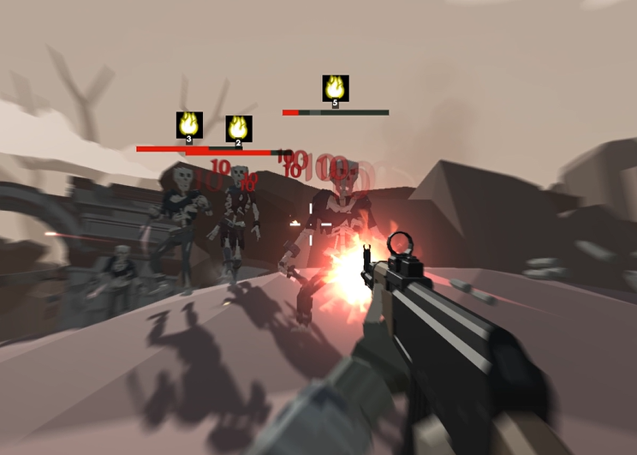
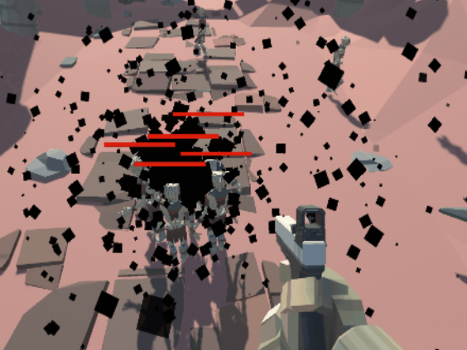
Atom Break
(Bullet time)
By collecting the top rarity attachments, player could form attachments sets and unlock 5 hidden attachment skills as reward.
Leviathan
(Black hole)

